Slide 1

Augmented Reality
Charlotte Bourdin – Conghui Chen – Jenny Guan
Xizi He – Jeff Moore – Ben Norris

Slide 2
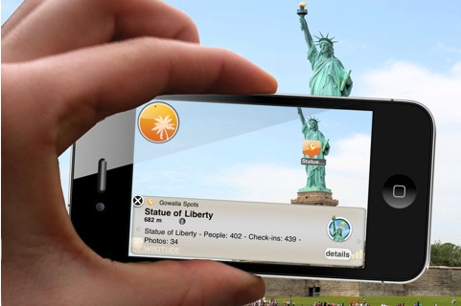
Agenda
Definition
History & Current State
Technology Behind Augmented Reality
Current Business Uses
Future of Augmented Reality
Concluding Remarks

Slide 3
Definition
Introductory Video
Technology that superimposes digital content on the real world
Differentiating AR and VR
AR → Immerses you in the real world
VR → Immerses you in a virtual world
Major Business Consequences

Slide 4
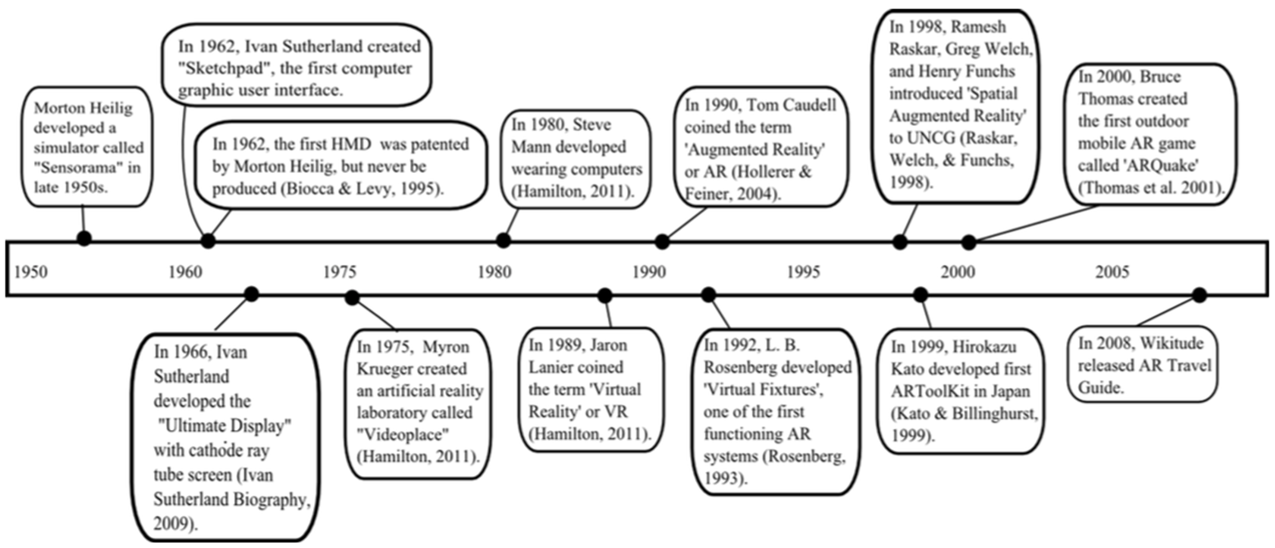
History & Current State

Slide 5
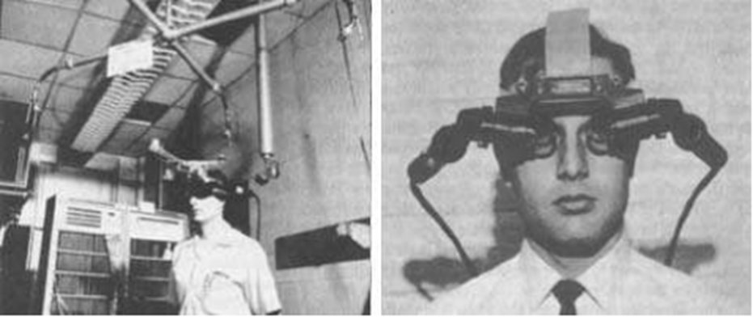
History & Current State
1950s →Sensorama
1962 → Head Mounted Display
Early 1990s → Birth of AR
Notes:
1950s: Sensorama - cinematic experience to take in all your senses, impressive but never sold commercially.
1962: The head-mounted display or HMD. The first step in making AR a usable possibility. Too heavy to bear, limited graphical prowess, provided simple wireframe models of generated environments.
Early 1990s: Birth of AR. Apply VR technology. Overlay the positions of certain cables in the building process.

Slide 6
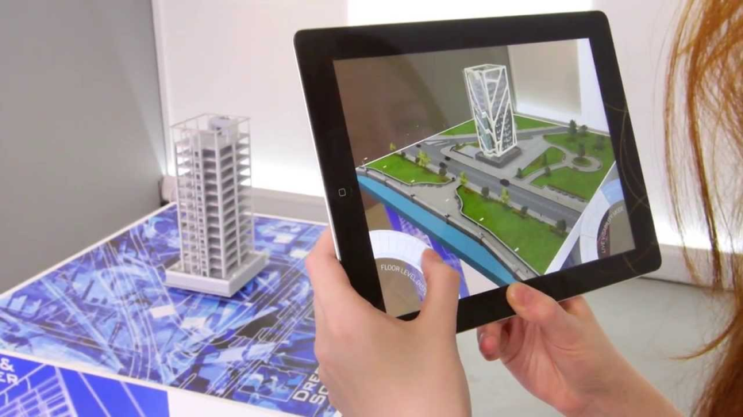
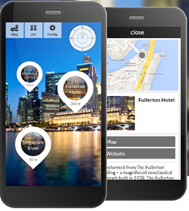
History & Current State
Late 1990s → Growth of AR
2008 →1st AR Mobile Application
Today → Preponderance of AR Apps
Notes:
Late 1990s: several conferences and organizations on AR formed. - Available software toolkits (ARToolKit) rapidly build AR applications - Several surveys give an overview on AR advances, describe its problems, classify and summarise developments.
2008: the first AR apps come to smartphones. Wikitude - see augmentations on the screen of points of interest nearby.
More recently: nearly 1.4 billion annual downloads of apps worldwide by 2015. More focused on small mobile devices, in the areas of marketing and entertainment.

Slide 7



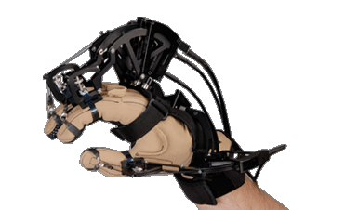


Technology Behind Augmented Reality
In General, all have:
Display, processor
Most have:
Sensors
Some Have:
Speakers
Force feedback
Internet connectivity
3D space
Notes:
Since there are a multitude of different types of AR, there are also a multitude of different ways of making it work.
At its most basic however, AR is simply a way of adding information to the world. This means using something that projects information onto our view of the world. Thus, AR almost always includes some way of producing additional information. This can be video, sound, tactile,
When AR becomes more complex, more components are added
- computer
- sensors
- screens
- HMDs

Slide 8
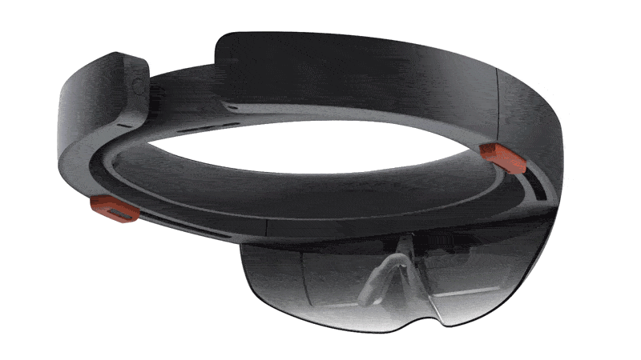
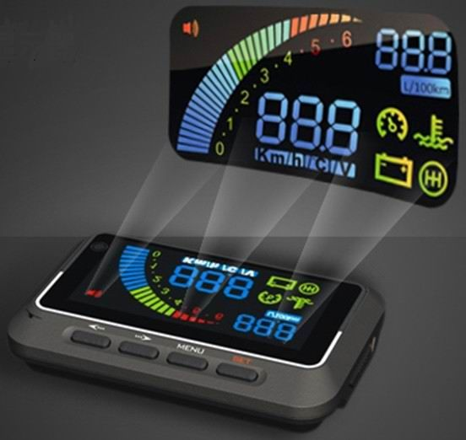
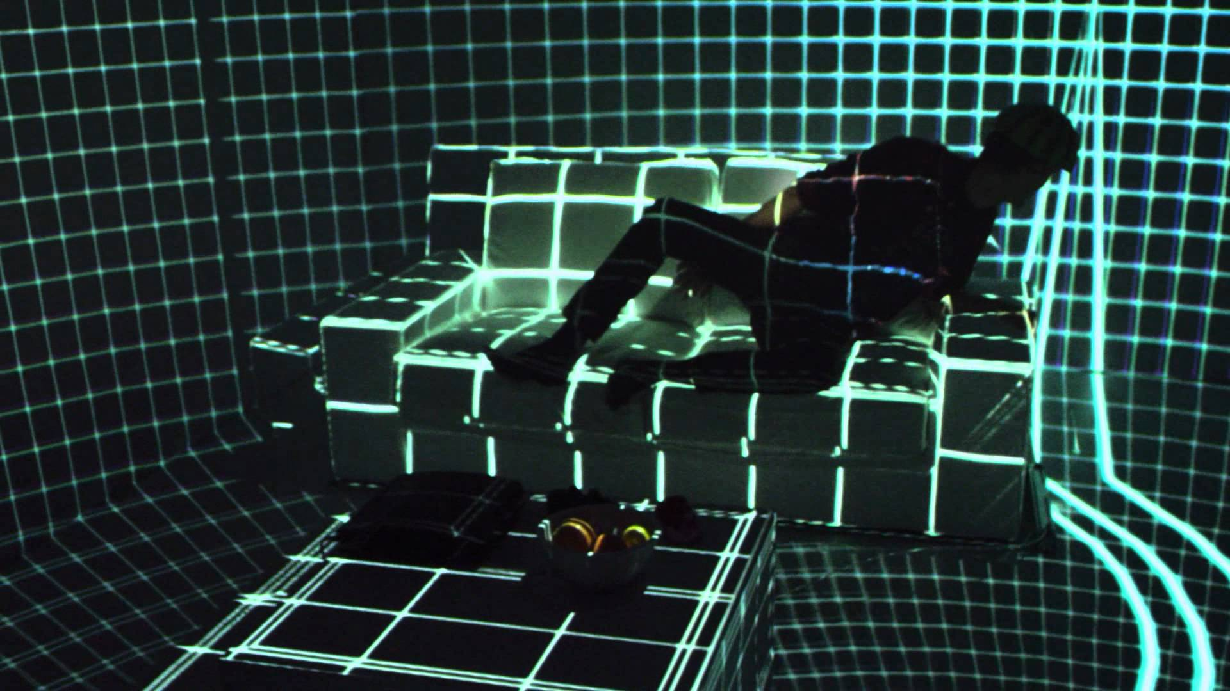
General Features
Projector / Display
Notes:
Augmenting reality with images is the most typical form of AR, and as such, a display or projector is almost always present. Without adding something to our senses, there is no augmentation to our reality.
A simple example is a car’s HUD. Such a HUD is a form of AR. As the video illustrated, pilots have been using AR in the form of HUDs for years.
Images can be projected onto the real world so everyone near can see it, or it can be personal, such that the image is only projected onto your own personal screen, such as in the Microsoft HoloLens
Could be a TV, laptop screen, projector, windshield of car or airplane, glasses lenses, smartphone screen

Slide 9

General Features
Processor
GPU and CPU
Fast
Allows interactivity
Notes:
The processor is the next component that contributes to an AR experience.
The processor can do tasks as simple as generating the time, or as complex as searching a network or database for appropriate information to overlay.
Exactly what type of processor setup is available depends on the type of AR experience. In a cellphone for instance, since the apps are geared mainly towards supplying the user with information, the image fluidity doesn’t matter as much as the accuracy of the information. As such, the GPU is not as important, while the emphasis may be on having a fast internet connection or a large amount of flash memory to process large database queries quickly.
In Head Mounted Displays, such as Microsoft’s HoloLens, the push in processors designed for AR is towards speed and low latency. This is so that images and information is updated in real time (as fast as someone moves their head or hand while holding a phone, preventing something called ‘jutter’, where the image doesn’t update at the same rate as it should, sometimes causing motion sickness. Latency is the time between a change and the update to accommodate for that change.

Slide 10


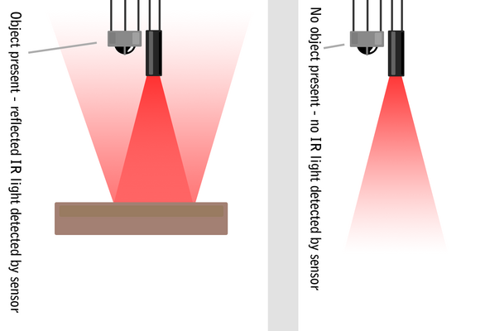
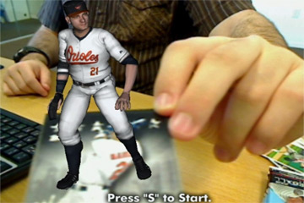
Added Features
Sensors / Markers
3D space
video
Notes:
Once AR becomes interactive, you start to need more hardware to allow you to interact with the information or to overlay the information in an accurate or relevant way. This requires sensors or markers.
A marker works in much the same way as a QR code does, in that the computer can detect the high contrast differences on the marker and translate this into a binary code. The outline of the marker also provides the processor with positional information, so it can track where the camera is in space relative to the markers. Some applications can also use a tracker that is not a QR-like code. For instance, the Total Immersion AR App uses the edges of a baseball card to track the object and where the information should be projected.
Sensors can include cameras, microphones, and IR lights and cameras. These are used to gauge size, distance, and spatial orientation of the real world so that the image to be projected fits into that real world unobtrusively and follows the movements of the user. A good example of using spatial input sensors can be seen in this video.

Slide 11
Added Features
Internet
Speakers / headphones
Force Feedback
GPS, Gyroscopes, Accelerometers
Notes:
The Internet is also an added layer, which is very common in most AR smartphone Apps. Information that is retrieved from the camera can be either analyzed on the local phone or sent to the cloud to be processed.
Displaying information about the world around you is achieved by combining a multitude of information into one unified view. This can mean getting information from many sources, such as GPS, internal gyroscopes, as well as internet databases or image processing software APIs.
With force feedback, the user gets a sense of what the virtual objects feel like in terms of their surface topography. In this sense, the glove is adding tactile information. In the same way, headphones or speakers can add audio information.

Slide 12
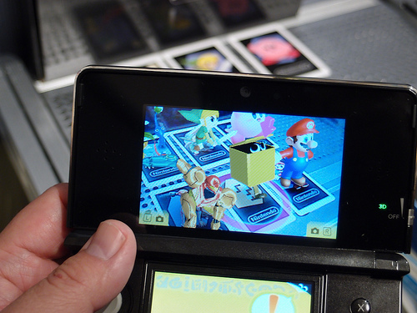
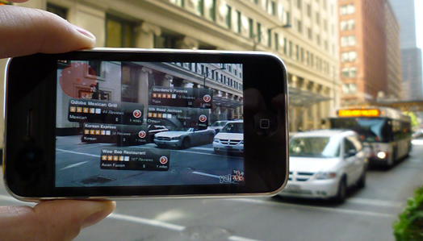
Current Business Uses
New Opportunities for Businesses
Mercedes-Benz
Video Games
IKEA → Video
Yelp!
Education

Slide 13
Future of Augmented Reality
Xizi He

Slide 14
Concluding Remarks
Jenny Guan

Slide 15
Thanks for listening!
Question Period

Slide 16
References
D.W.F. van Krevelen and R. Poelman. 2010. A Survey of Augmented Reality Technologies, Applications and Limitations. Systems Engineering Section, Delft University of Technology, Delft, The Netherlands
Yuen, S.; Yaoyuneyong, G.;& Johnson, E. (2011). Augmented reality: An overview and five directions for AR in education. Journal of Educational Technology Development and Exchange, 4(1), 119-140.
Dan Sung, March 1, 2011. The history of augmented reality http://www.pocket-lint.com/news/108888-the-history-of-augmented-reality. Retrieved on March 29, 2015
Pocket-lint. How Does Augmented Reality Work? http://www.pocket-lint.com/news/108884-how-does-augmented-reality-work Retrieved on March 30, 2015

